Slide 1
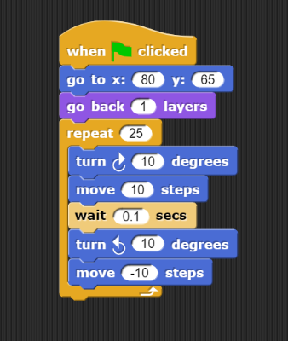
Order Requirement Digraphs with SNAP
6
D
5
B
A
E
F
10
7
3
C
4

Slide 2
SNAP Assignment
Complete the Guided SNAP Activity
Make a Unique Program

Slide 3
SNAP Overview

