Slide 1
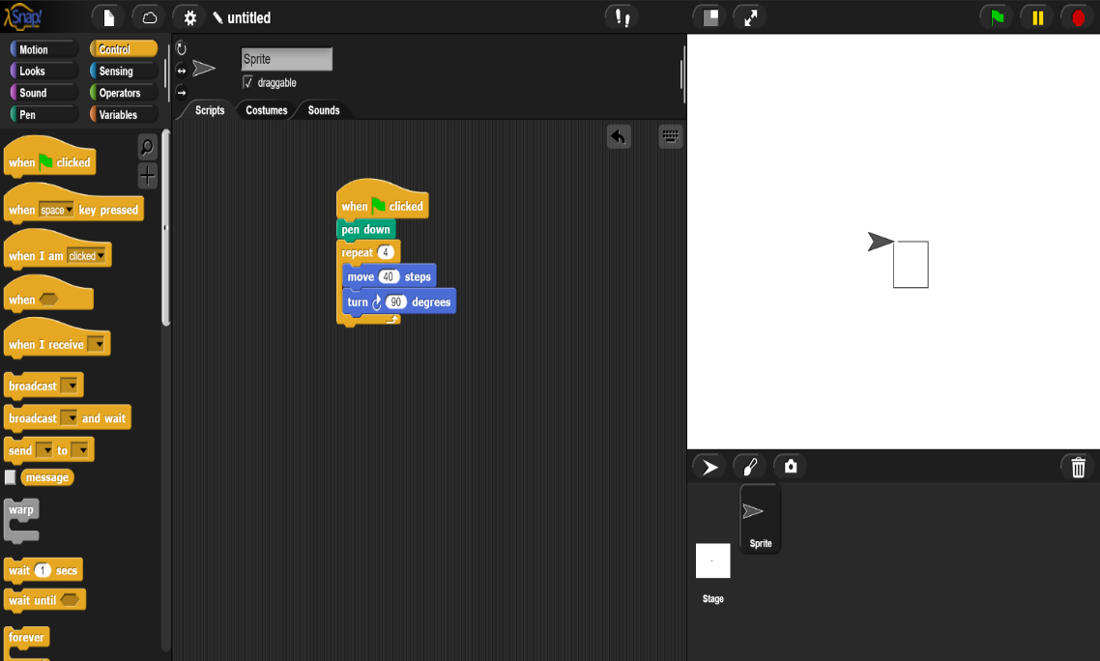
“Relating Geometric Figures to Writing Code in SNAP”
Summary: Students will use the computer program SNAP to gain an insight into using logical reasoning skills with geometric shapes. They will first be given a step-by-step introduction to SNAP, then create geometric figures using the program.
Goals:
Write basic codes in SNAP
Create quadrilaterals using the SNAP “Sprite”
Create complex shapes and drawings using SNAP
Use logical reasoning to solve complex proof-like problems

Slide 2
SNAP Overview

