Slide 1
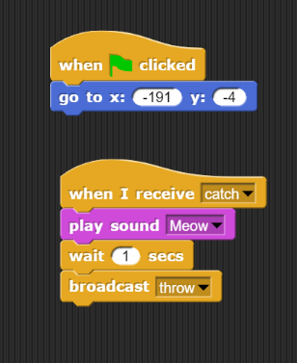
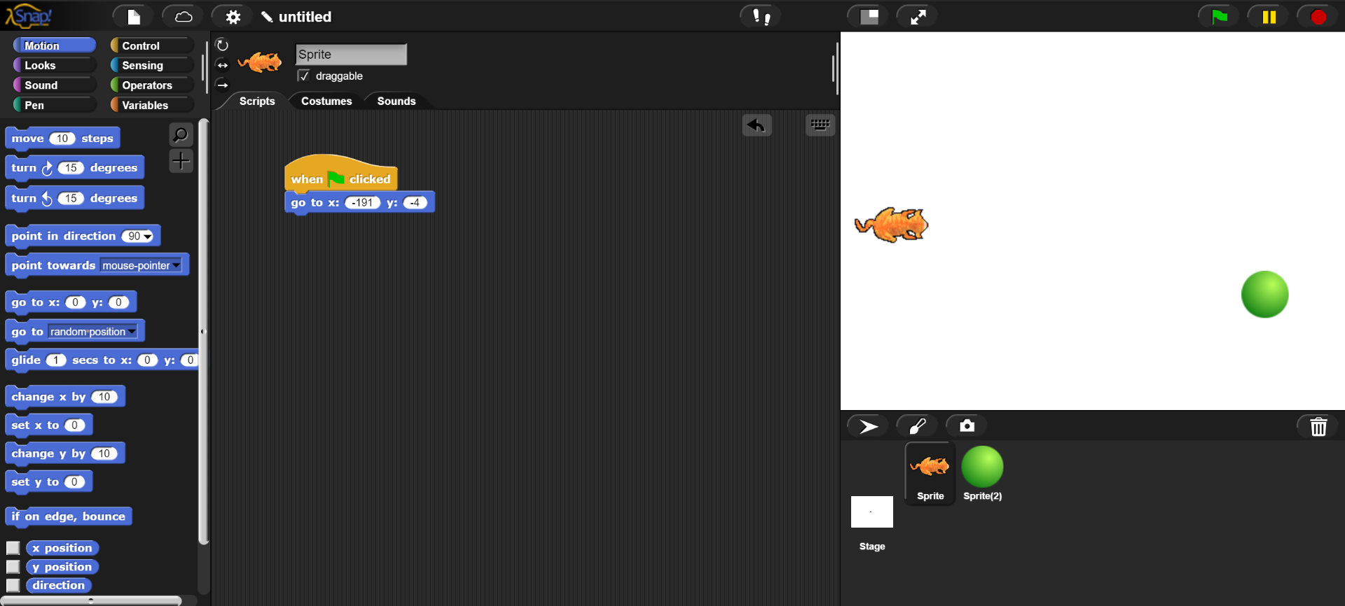
You will create a program in SNAP following a guided example.
You will create pseudocode for a SNAP program.
You will create your own SNAP program.
You will calculate (show) angle of deflection.

Slide 2
SNAP Overview

