Slide 1
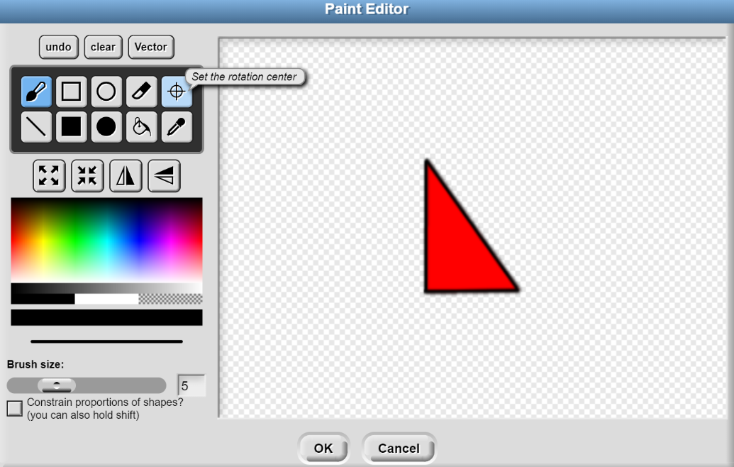
“Transformations Using SNAP”
Summary: Students will examine SNAP code to identify the logical thought processes behind creating transformations in coordinate plane. Students will also create their own code to preform transformations. SNAP will enhance the mathematical visualization of transformations.
Answer the following questions:
If your sprite is reflected over the x-axis, what is the affect on the Sprite’s center coordinates?
If your sprite is reflected over the y-axis, what is the affect on the Sprite’s center coordinates?
If your sprite is reflected over the origin, what is the affect on the Sprite’s center coordinates?
How would dilations be helpful if you were a computer animator?
When your Sprite was dilated, did the Sprite’s center coordinates change? How could you write your code to prevent this from happening?

