Slide 1
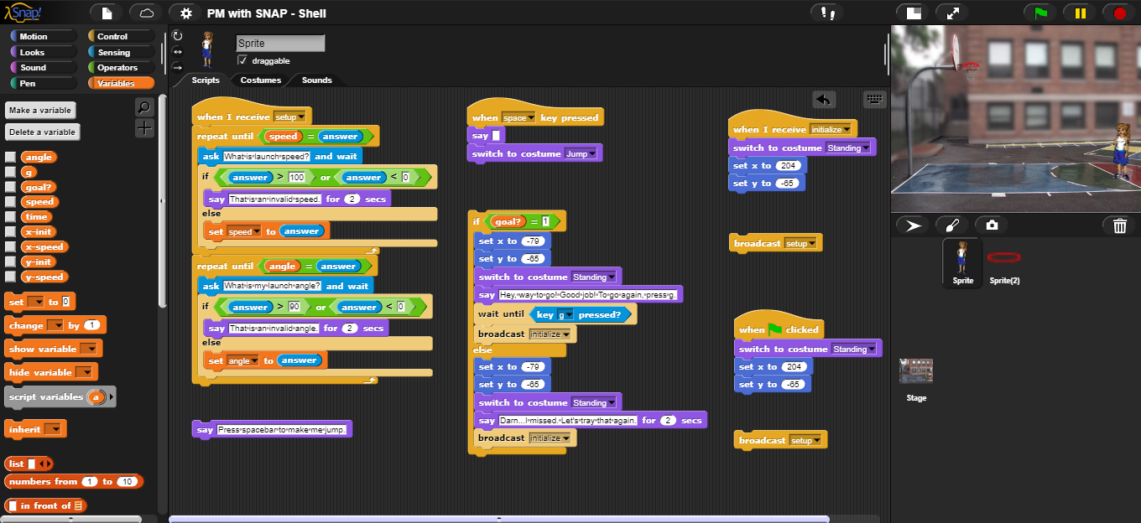
“Modeling Projectile Motion in SNAP” Summary: This module is designed to introduce some of the more robust applications of SNAP. This module will help solidify physics ideas while improving on a student’s programming skills.
Lab Activity
Pre and Post Questions Programming Tips and Challenges
Things to Consider:
What variables do you need to consider for projectile motion?
Do you need to consider a horizontal acceleration? If so, what would it be?
What equations are you going to need to use in your model?
How are you going to handle input and output?
How will you check to see if the shot is successful?
Would this be a realistic model for real life?

