Slide 1
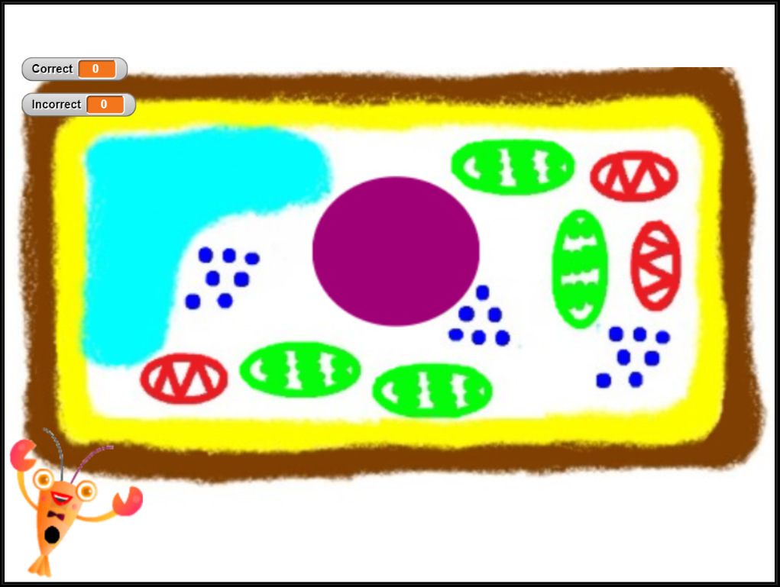
Activity Title: “Cell Part Identification using SNAP”
You will complete the following:
-identify different parts of a cell when prompted by a question
-go into the program and gain an understanding of how the code works -create your own review program on a chloroplast, mitochondrion, or cell membrane

