Slide 1
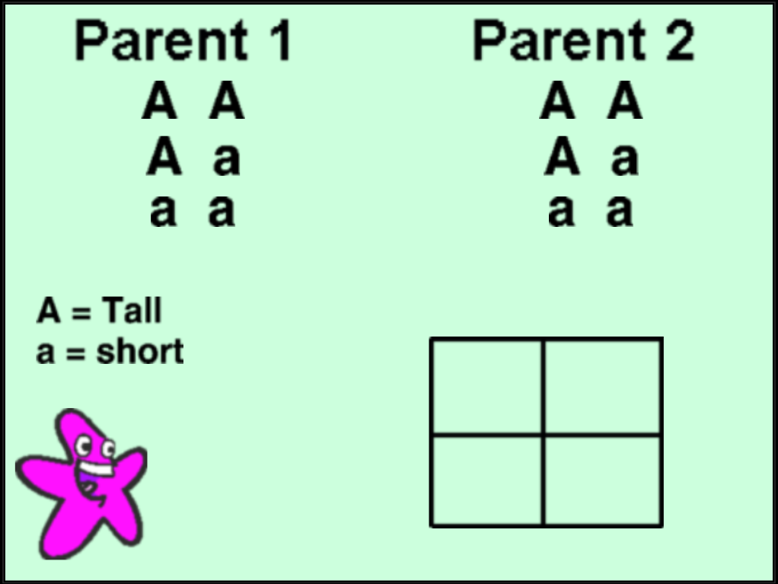
“Punnett Squares with SNAP”
Summary: Gregor Mendel did extensive research with pea plants that contributed to genetics today. Developing and using Punnett Squares to predict possible genotypes and phenotypes was an important factor in Mendel’s work. In this activity, you will apply Mendel’s use of Punnett Squares by using SNAP and simple coding. Students will complete a teacher made SNAP project and develop their own SNAP project based on the teacher made project.
Assessment:
Students will share their project with the teacher and another student. Students will turn in a ½ page write-up on another students project they critiqued. Critiques should include positives about the project and suggestions for improvement.
http://blogs.dulwich-beijing.cn/daphneko/blog/tag/SNAP/

