Slide 1
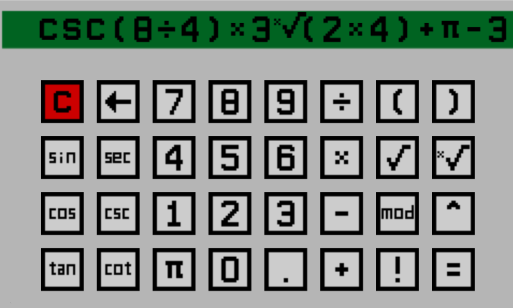
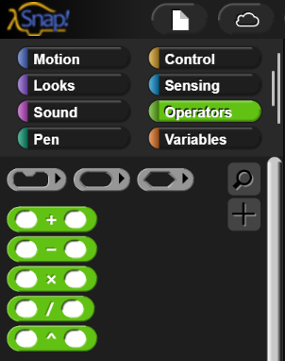
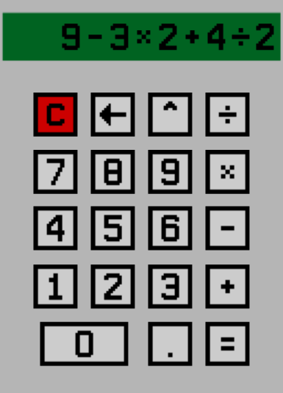
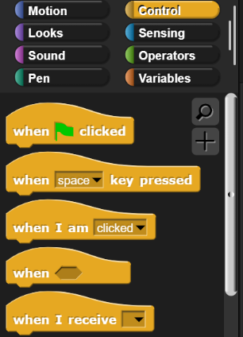
“SNAP Calculator” Summary: Students are required to build a functional four operation calculator by using SNAP. The goal is to become familiar with handling input/output functions as well as the mathematical functions in SNAP. For added complexity, students in more advanced courses could be required to include other operations and functions (e.g. square root, powers, and trigonometric functions).
Basic and Advanced Lab Activities
Follow Up Questions Programming Tips
Things to Consider:
How are you going to handle input and output?
How many variables will you need to implement?
How will you clear or reset inputs and outputs?
How will you initiate the operation?
How will you handle unacceptable operations? E.g. Divide by 0.

