Slide 1
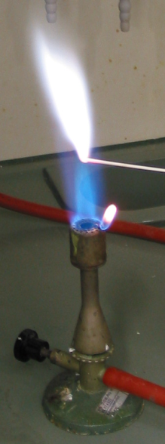
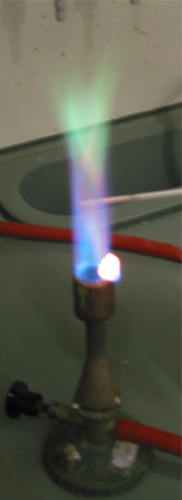
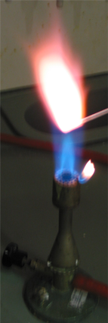
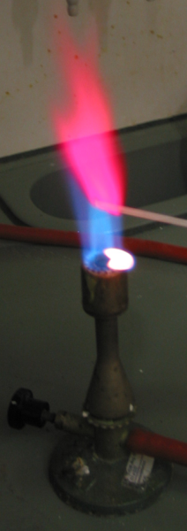
“Flame Test Identification with SNAP”
In this activity, you will discover the characteristic flame produced by various elements when lit in a Bunsen burner. You will use SNAP to simulate each test. Think about the following questions while completing the activity:
Why is the flame test such a useful tool in element identification?
Why do you think each element produces its own color?
Can you think of other practical uses that would take advantage of this phenomenon?
Salt | Color of Flame
Aluminum chloride
Sodium chloride
Copper (II) chloride
Potassium chloride
Calcium chloride

