Slide 1
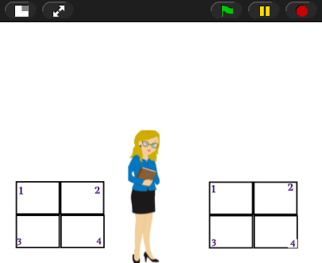
Activity Title: “Genetic Inheritance”
You will complete the following:
-Visualize Punnett squares, Inheritance, genotype/ phenotype ratios, dominance vs recessive traits, incomplete dominance, and codominance.
-Gain an understanding of how the SNAP
code works
-Create your own review program on a
inheritance & Punnett squares in SNAP

