Slide 1
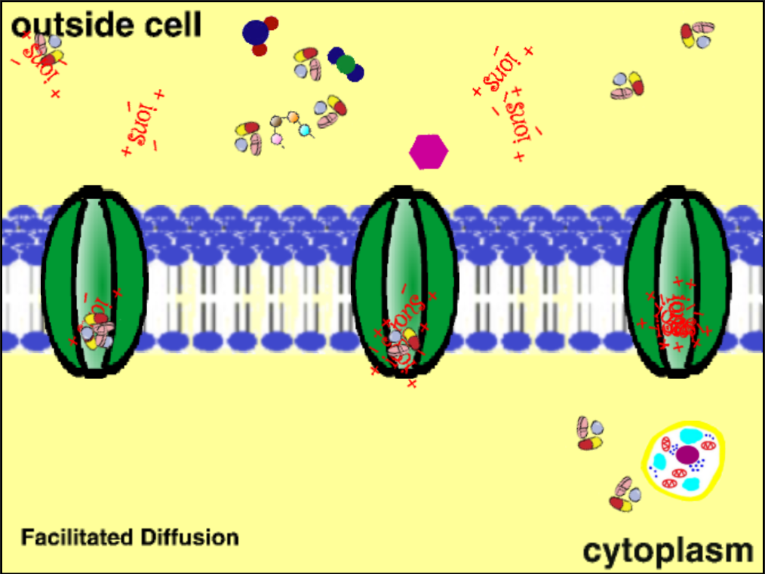
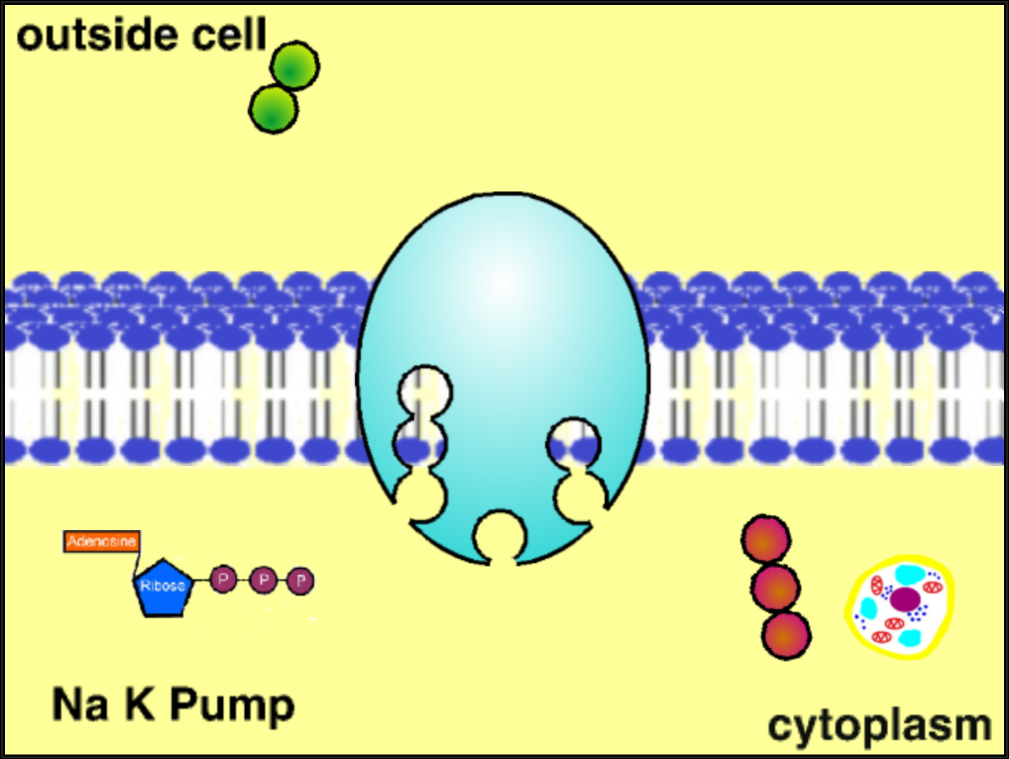
“Cell Transport”
Summary: In this activity, you will use SNAP to examine different cell transport methods. You will answer questions regarding cell transport while watching demonstrations of how they operate.
What are the two main types of cell transport?
How does diffusion differ from osmosis?
What is facilitated diffusion?
How does endocytosis differ from exocytosis?
How does the sodium-potassium pump work?

