Slide 1
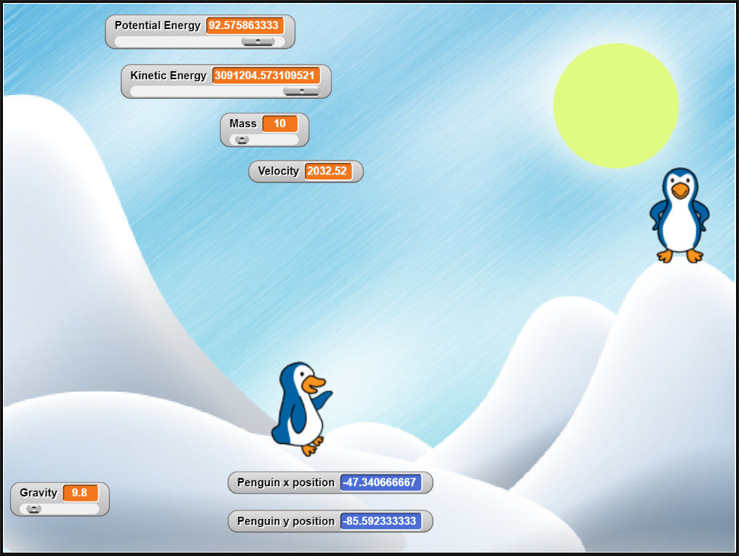
“Reinforcing Kinetic and Potential energy with SNAP”
Summary: In this activity, students will use SNAP programming to reinforce basic knowledge in Potential and Kinetic energy. Students will compare the effect, if any, when changing the mass, on the Potential and Kinetic energy. Students will have an opportunity to manipulate variables in SNAP to enter the formula in calculating the Kinetic energy of the sprite. Students will have the opportunity to visualize how the Kinetic and Potential energy change as the sprite moves around.
What happens to the Potential energy when mass increases? When mass decreases?
What happens to Kinetic energy when mass increases? When mass decreases?

