Slide 1

PPLANE8 & Double Pendulum
Zachary Bryan
Morgan Rouse
Catherine Thomas
Figure 1: MATLAB logo¹

Slide 2
1st Project
Looked into creating a program that Dr. Marland could use as a teaching tool
Wanted a program that:
  Takes in a set of coupled 1st order D.E.’s
  Plots the phase plane
  Allows you to play with parameters to get a better understanding of bifurcation values

Slide 3
PPLANE8
Written by John C. Polking at Rice University
Wanted to:
  Make the GUI more user friendly
  Allow the user to change the parameters with a scroll bar
Demo
Found out the code was too hard to decipher (over 7400 lines of code)

Slide 4

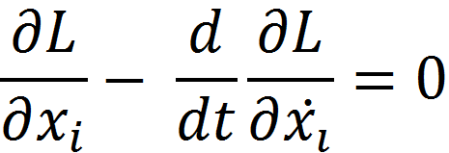
Lagrangians in Classical Mechanics
“The Lagrangian, L, of a dynamical system is a function that summarizes the dynamics of the system.”²
One can determine the equations of motion of the system by using the Euler-Lagrange equation.

Slide 5
Double Pendulum
Figure 2: Schematic of a double pendulum³

Slide 6
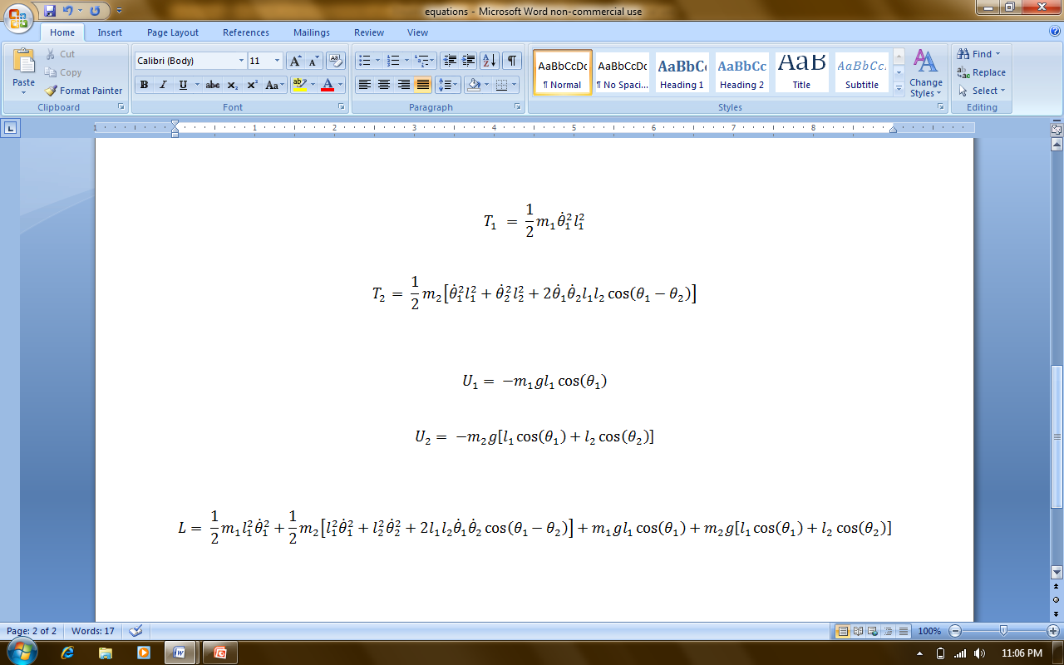
Double Pendulum

Slide 7
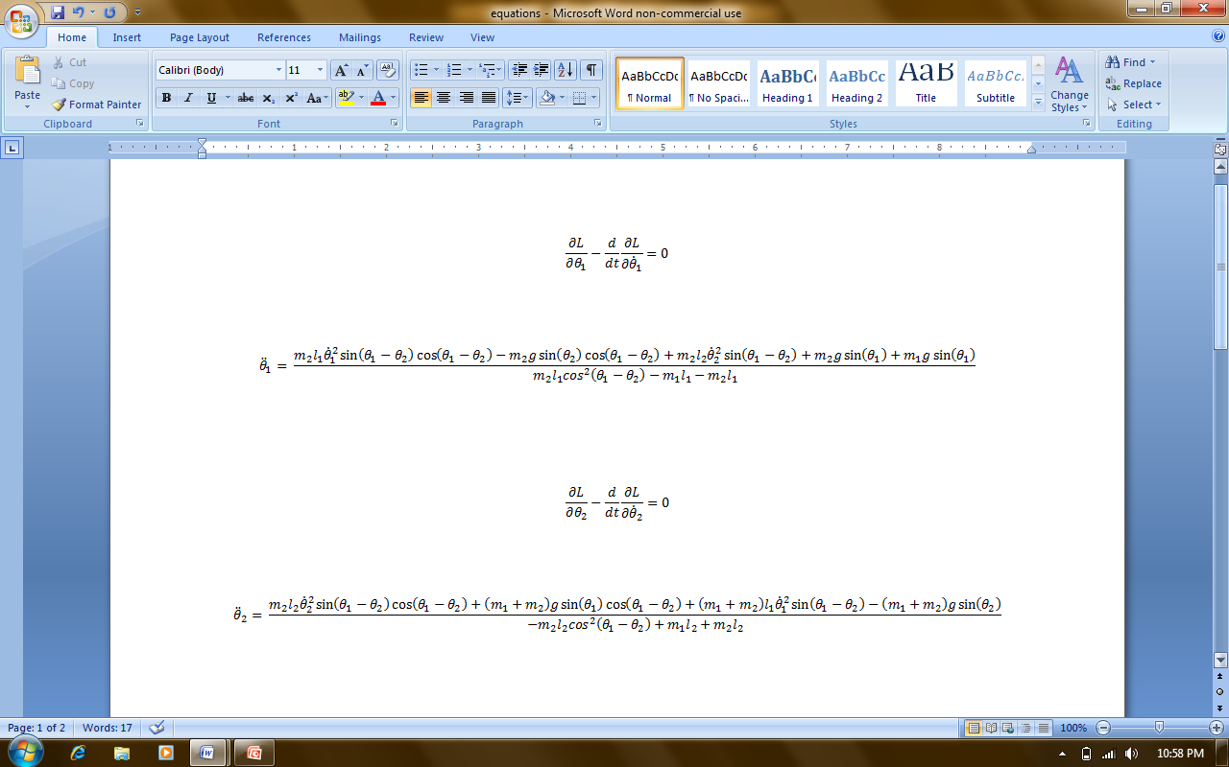
Double Pendulum

Slide 8
Double Pendulum
Found two sources of code online:
  doublePendulum.m written by Alexander Erlich
  dpend.m written by Matthias Kawski
Both impliment ode45, a D.E. solver that uses a variable step Runge-Kutta Method to solve differential equations numerically

Slide 9
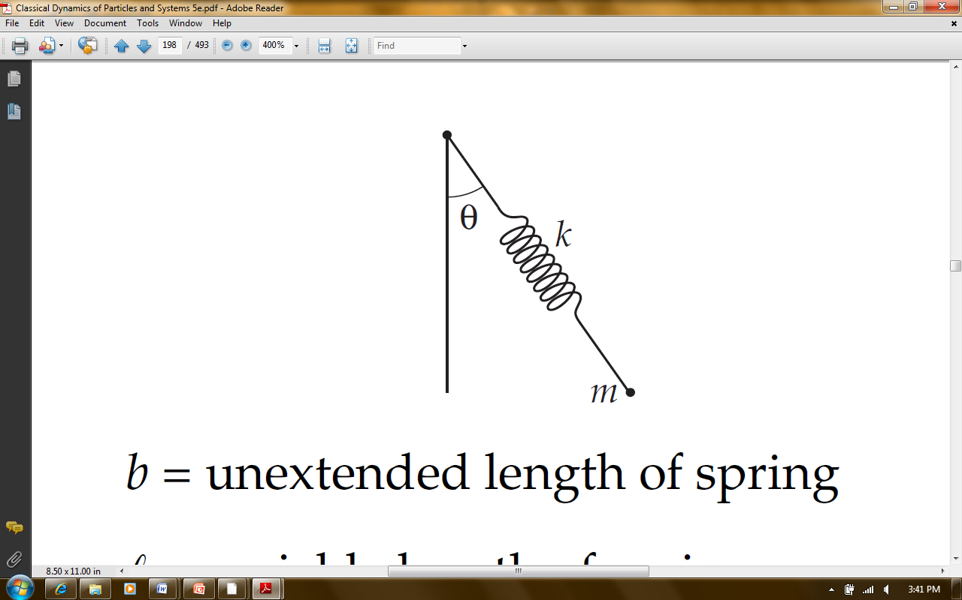
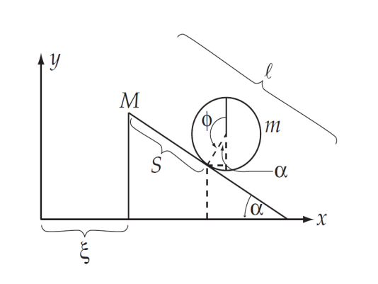
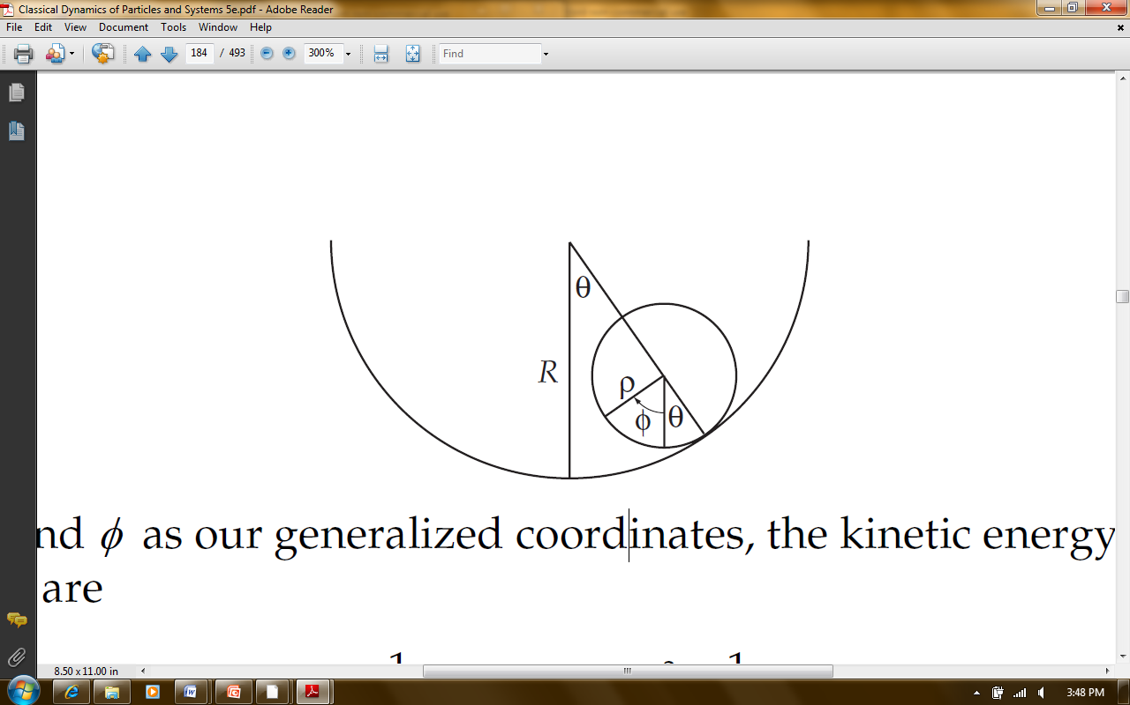
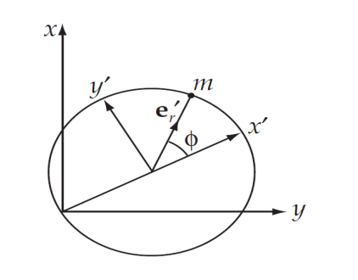
Future Plans
Make a better looking GUI for the double pendulum system
Create GUI’s for other classical systems:

Slide 10
References
  http://his.cuahsi.org/images/matlablogo.jpg
  http://en.wikipedia.org/wiki/Lagrangian
  http://online.redwoods.cc.ca.us/instruct/darnold/deproj/

Slide 11
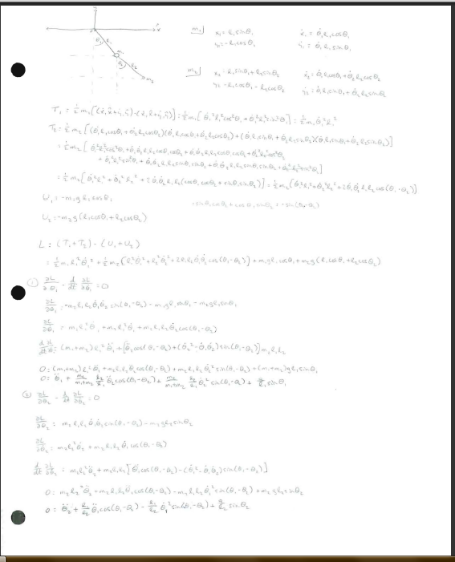

Slide 12
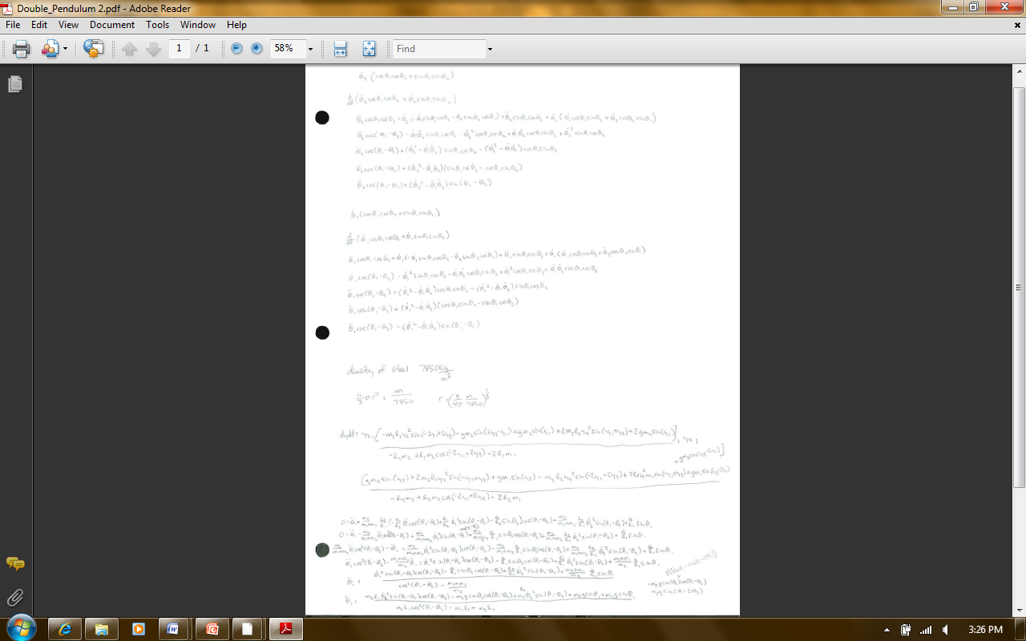

Slide 13
